Slide 1
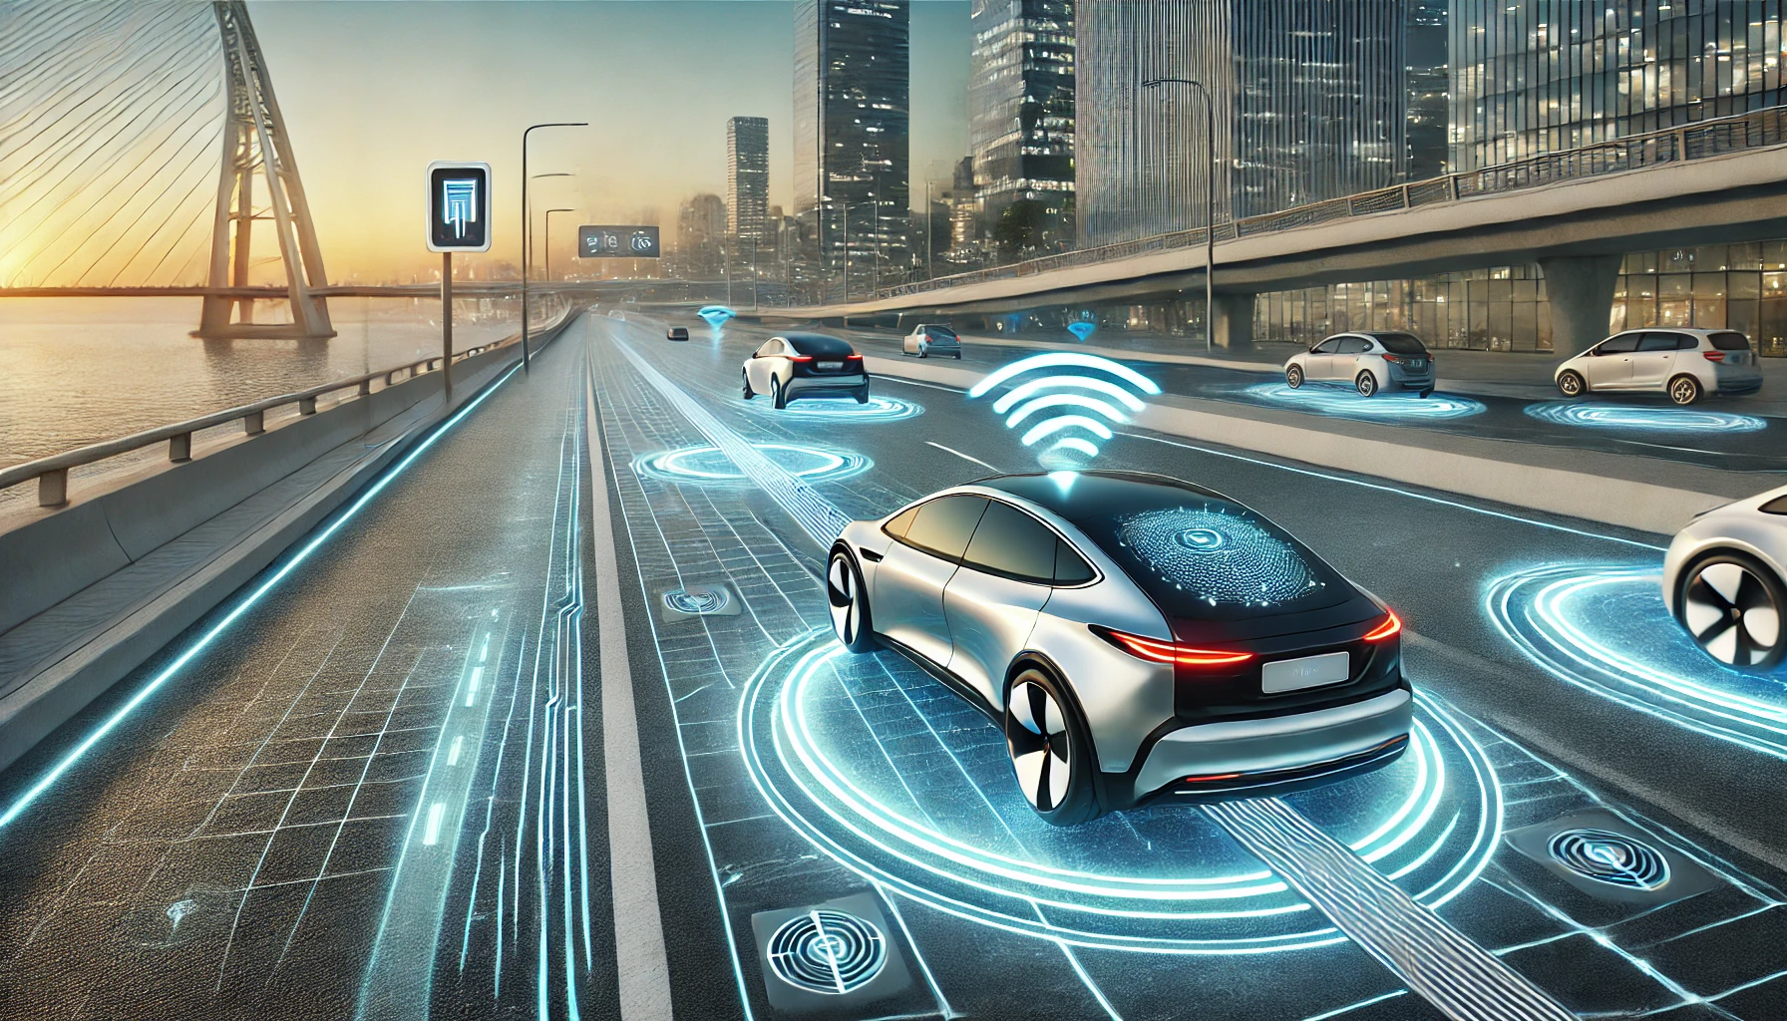


DYNAMIC WIRELESS CHARGING FOR EV

Slide 2
Mentor/Mentee Details:
MENTOR : T. Nikshitha
MENTEES: Adarsh Akshat
Meghana Rajashekar
Rewanshi
Mentor Details
08

Slide 3
Introduction :
The increasing adoption of electric vehicles (EVs) highlights the need for more convenient and efficient charging methods. Traditional plug-in charging systems for electric vehicles (EVs) are often inconvenient and prone to wear, prompting interest in wireless charging solutions. Wireless charging can eliminate the need for physical connectors, making charging more efficient and seamless. However, key challenges include optimizing power transfer efficiency, ensuring safe operation, and integrating with existing infrastructure
Problem Statement
01

Slide 4
Problem Statement:
In dynamic wireless charging (DWC) for electric vehicles (EVs), ensuring efficient power transfer while the vehicle is in motion presents multiple challenges.
The inductance between road-embedded transmitter coils and the EV's receiver coil changes, affecting power transfer efficiency.
Only the coil beneath the EV should activate at the right time to reduce energy wastage and electromagnetic interference (EMI).
Power transfer occurs in bursts, leading to an uneven power supply to the battery.
Buck-Boost converters should regulate battery voltage under varying speeds, coil spacings, and load conditions.
Problem Statement
01

Slide 5

Project Description:
Concept: Dynamic Wireless Charging (DWC) for electric vehicles (EVs) enables continuous energy transfer while the vehicle is in motion.
However, challenges such as mutual inductance variation, coil activation efficiency, and power transfer stability must be addressed to improve the system’s effectiveness.
Background, Past Work: Wireless power transfer (WPT) technology has been widely explored for static charging applications.
Prior studies have worked on optimizing coil placement, power electronics, and efficiency improvement methods.
Scope and Limitations: The scope includes modeling mutual inductance variation, designing an intelligent coil activation strategy, and implementing power regulation using DC-DC converters.
This study does not extend to real-world road implementation, large-scale infrastructure development, or long-term reliability testing under practical conditions.
Project Description
03

Slide 6
Methodology:
1) System Design: Begin by designing the wireless charging system, selecting components such as inductive coils, power electronics, and necessary sensors. Utilize simulation tools like MATLAB to create circuit models and optimize design parameters for efficient energy transfer.
2)Implementation: Assemble the selected components on a prototype board, focusing on the alignment of the charging pad and vehicle receiver. Ensure that the power electronics are configured correctly for optimal energy flow during charging.
3)Testing and Calibration: Perform thorough testing to verify system functionality and efficiency. Adjust the alignment and power control mechanisms based on test results to enhance performance.
4)Data Analysis: Analyse the collected data to evaluate system performance, focusing on metrics like energy transfer efficiency and safety.
5)Documentation and Presentation: Prepare detailed documentation of the design process, testing results, and analyses. Present the project to demonstrate its functionality and discuss its significance in the context of EV charging infrastructure.
Methodology
05

Slide 7
Work done
We have successfully completed the simulation for static wireless charging, gaining valuable insights into its efficiency and performance. Alongside this, we have thoroughly explored the theoretical aspects of dynamic wireless charging. Now, we are moving forward with its implementation, focusing on simulating continuous power transfer to EVs while in motion to enhance practicality and scalability.
What will the students learn
04

Slide 8
Timeline for Project Completion :
Task Name | Expected Time (answer in terms of days/week)
Implementation of Simulation | 1 week
Validation and Testing of Simulation
Hardware Implementation | 2 week
Report Preparation and Documentation | 3-4 days
Final Presentation and Review | 2-3 days
Pre-requirements
07

Slide 9
Thank you!

